Slide 1
Minimization strategies in ptychography
Adaptative step length

Slide 2
Outline
Minimization strategies theory
Code to calculate and adaptative step length for object correction and angular positions correction
Application to simulated data

Slide 3
Bragg Coherent Diffraction Imaging (BCDI)
Geometry of the experiment and rocking curve scan

Slide 4
Introduction
Sample and experiment
Detector
Incoming beam
Outgoing beam

Slide 5
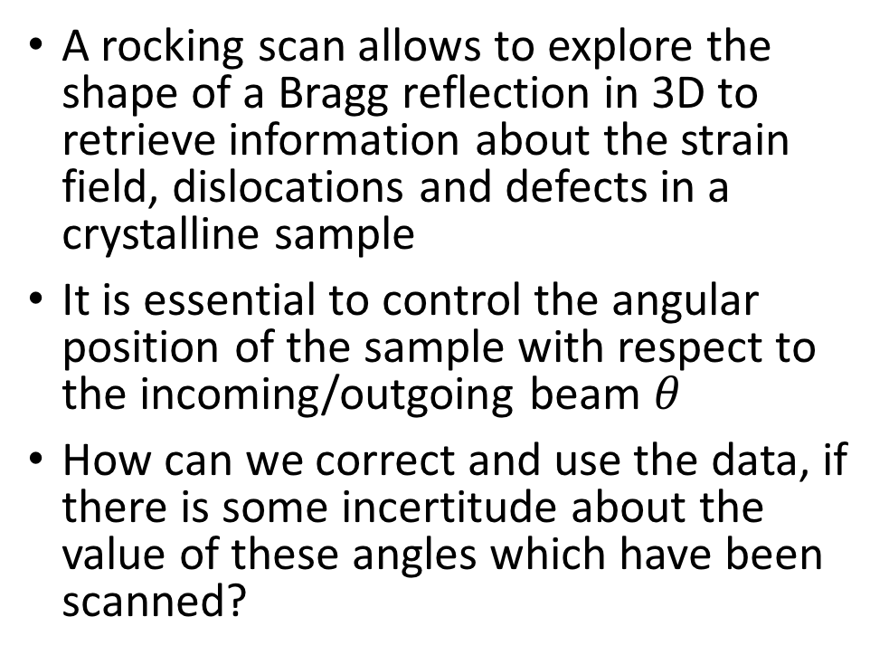
Introduction:
A rocking scan allows to explore the shape of a Bragg reflection in 3D to retrieve information about the strain field, dislocations and defects in a crystalline sample
It is essential to control the angular position of the sample with respect to the incoming/outgoing beam $θ$
How can we correct and use the data, if there is some incertitude about the value of these angles which have been scanned?

Slide 6
Theory of adaptive step to improve BCDI
Improving steepest descent algorithms and application to the rocking curve scan angles

Slide 7
Steepest descent method
Is a category within the general line search method
The goal is to find the value of the variable x* which minimizes a certain function f(x):
We use the Taylor expansion of f(x) to explore its behavior in the vicinity of x_0 (initial value of the variable x) and to decide the new step: x_0+𝛅x

Slide 8
Steepest descent method
How to calculate the step? if x* = x_0+𝛅x is a minimizer, then:

Slide 9
Steepest descent method
In the case of a BCDI experiment, the function that we want to minimize is the error metric defined as:
Measured
intensity
Calculated intensity:
Calculated diffracted wave:

Slide 10
Steepest descent method
Therefore we need to calculate the step which brings us from:
Applying the formula derived from the definition of minimizer and the Taylor expansion of the error metric function around \theta_{\hat{j}}, we obtain:

Slide 11
Beyond the steepest descent: Minimization strategies theory
Adaptive step length theory (Marc Allain):
Step beyond the Newton method where the step taken along variable x to minimize the function f(x) is given by:
The Newton approach is inconvenient whenever we are far away from the minimum of f(x) at x_0, because f(x) is no longer well approximated by:

Slide 12
Minimization strategies theory
Adaptive step-length theory (Marc Allain):
We need a new approach… to take from Marc’s note

Slide 13
Application of adaptative step to simulated data
Series of test on the rho and theta corrections

Slide 14
Rho retrieval
Non distorted grid, perfect initial guess and noisy data

Slide 15
Theta retrieval
Non distorted grid, perfect initial guess and noisy data
/…/Nanowire_ptychograpy/Irene_analysis/Theta_adaptative_step/results/NW_results_angle test
Error metric
Angles
Object
iterations
iterations

Slide 16
Theta retrieval
Non distorted grid, perfect initial guess and noisy data

Slide 17
Theta retrieval
Distorted grid, perfect initial guess of rho, but wrong initial guess of angles and non-noisy data

Slide 18
Theta retrieval
Evolution of the angle value at different positions of the rocking curve
Rocking angle, theta

Slide 19
Theta retrieval: correcting the rocking curve
40 Iterations
Rocking angle
Rocking angle

Slide 20
Theta and rho retrieval
Perfect initial guess but distorted angles.
Rho and theta algorithm

Slide 21
Rocking curve correction

